Slide 1
Solving PDEs using physics-informed neural networks (PINNs): some examples
I. Chaerony Siffa, 23 January 2024
INP supervisor: Dr. Markus M. Becker
Univ. supervisor: Prof. Jan Trieschmann (CAU Kiel)

Slide 2
Outline
Recap on artificial neural network
PINN examples:
1d harmonic oscillator
2d elliptic problem
Time-dependent 1d problem
Time-dependent 1d problem (inverse)
Parametrically solving the electron Boltzmann equation
Challenges
Concluding remarks
I. Chaerony Siffa, Kiel Seminar, 23 Jan. 2024

Slide 3
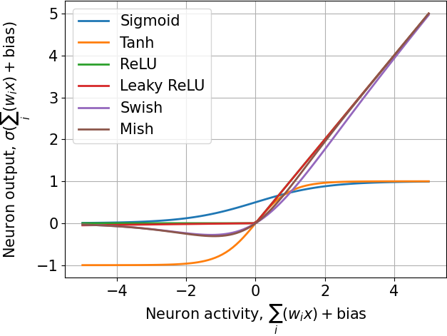
Recap: artificial neural networks (ANN)
Artificial Neural Network (ANN), $\hat{u}=NN(x;θ)$
Objective function
$$σ$$
…
$$σ$$
$$w_{1}$$
$$w_{50}$$
Compare with true value ($u$)
$$w_{2}$$
$$σ$$
$$σ$$
$$w_{51}$$
$$x$$
$$\hat{u}$$
Loss formulation, e.g., squared error
input
…
…
$$w_{n}$$
$$w_{10}$$
output
$$σ$$
$$σ$$
Use gradient descent to optimize $θ$
Parameters $θ=\{w_{1},w_{2},w_{3},…,w_{n},biases\}$
Activation functions, $σ\left(⋅\right)$
Learning rate
Using the automatic differentiation feature in PyTorch, TensorFlow, etc.
I. Chaerony Siffa, Kiel Seminar, 23 Jan. 2024

Slide 4
Recap: artificial neural networks (ANN)
Artificial Neural Network (ANN), $\hat{u}=NN(x;θ)$
Objective function
$$σ$$
…
$$σ$$
$$w_{1}$$
$$w_{50}$$
Compare with true value ($u$)
$$w_{2}$$
$$σ$$
$$σ$$
$$w_{51}$$
$$x$$
$$\hat{u}$$
Loss formulation, e.g., squared error
input
…
…
$$w_{n}$$
$$w_{10}$$
output
$$σ$$
$$σ$$
Use gradient descent to optimize $θ$
Parameters $θ=\{w_{1},w_{2},w_{3},…,w_{n},biases\}$
Activation functions, $σ\left(⋅\right)$
Typically used optimizers:
Stochastic Gradient Descent (SGD)
Root Mean Squared Propagation (RMSprop)
Adaptive Moment Estimation (Adam)
Limited-memory Broyden-Fletcher-Goldfarb-Shanno algorithm (L-BFGS): popular for PINNs
I. Chaerony Siffa, Kiel Seminar, 23 Jan. 2024

Slide 5
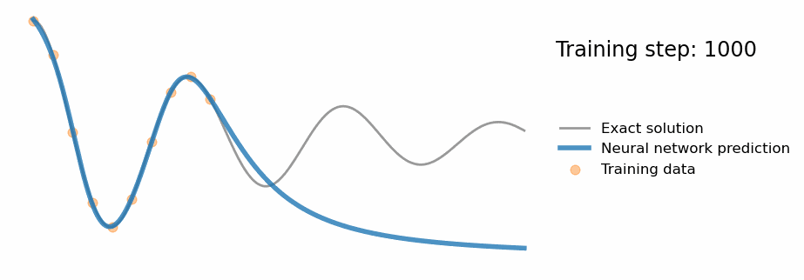
PINN example: 1d harmonic oscillator problem
Artificial Neural Network (ANN), $\hat{u}=NN(x;θ)$
Governing differential equation (DE)
$$σ$$
…
$$σ$$
Compare with true value ($u$)
$$σ$$
$$σ$$
$$x$$
$$\hat{u}$$
input
coordinates
…
…
Loss formulation
physical
quantities
$$σ$$
$$σ$$
Regular ANN:
Training iteration:
https://benmoseley.blog/my-research/so-what-is-a-physics-informed-neural-network/
Raissi et al. 2018 J. Comput. Phys. 378 (2019) 686–707
I. Chaerony Siffa, Kiel Seminar, 23 Jan. 2024

Slide 6
PINN example: 1d harmonic oscillator problem
Automatic
differentiation
Artificial Neural Network (ANN), $\hat{u}=NN(x;θ)$
Governing differential equation (DE)
$$σ$$
…
$$σ$$
$$\frac{d\hat{u}}{dx},\frac{d^{2}\hat{u}}{dx^{2}}$$
$$σ$$
$$σ$$
$$x$$
$$\hat{u}$$
…
…
Compare with true value ($u$)
Loss formulation
input
coordinates
physical
quantities
$$σ$$
$$σ$$
(Data loss)
(Physics loss / residual)
Regular ANN:
PINN:
Training iteration:
https://benmoseley.blog/my-research/so-what-is-a-physics-informed-neural-network/
Raissi et al. 2018 J. Comput. Phys. 378 (2019) 686–707
I. Chaerony Siffa, Kiel Seminar, 23 Jan. 2024

Slide 7
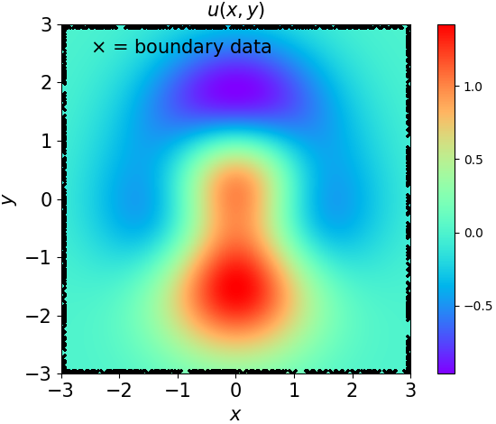
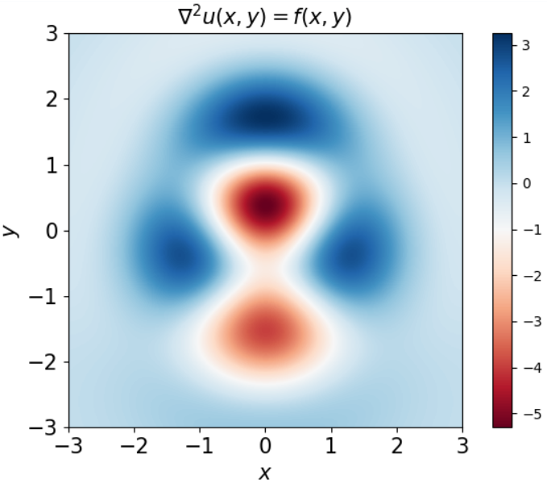
PINN example: 2d elliptic problem (Poisson’s, Laplace’s eq.)
Automatic
differentiation
Automatic
differentiation
Artificial Neural Network (ANN), $\hat{u}=NN(x,y;θ)$
Governing partial differential equation (PDE)
$$σ$$
…
$$σ$$
$$\frac{∂^{2}\hat{u}}{∂x^{2}},\frac{∂^{2}\hat{u}}{∂y^{2}}$$
$$x$$
$$σ$$
$$σ$$
$$\hat{u}$$
…
…
Compare with boundary data ($h$)
$$y$$
physical
quantities
input
coordinates
$$σ$$
$$σ$$
Loss formulation
(Physics loss )
(Boundary loss)
(Total loss)
True solution
Source term
I. Chaerony Siffa, Kiel Seminar, 23 Jan. 2024

Slide 8
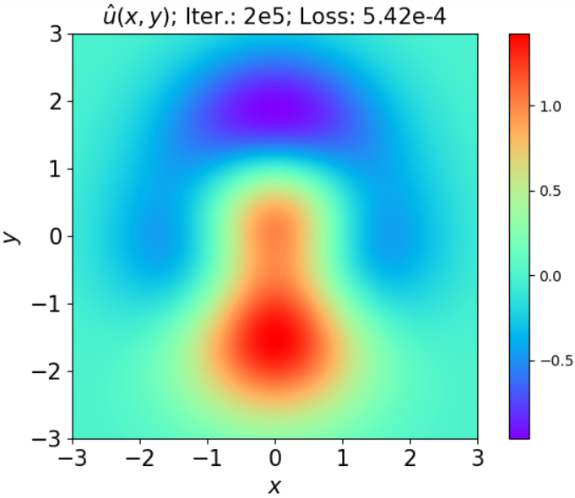
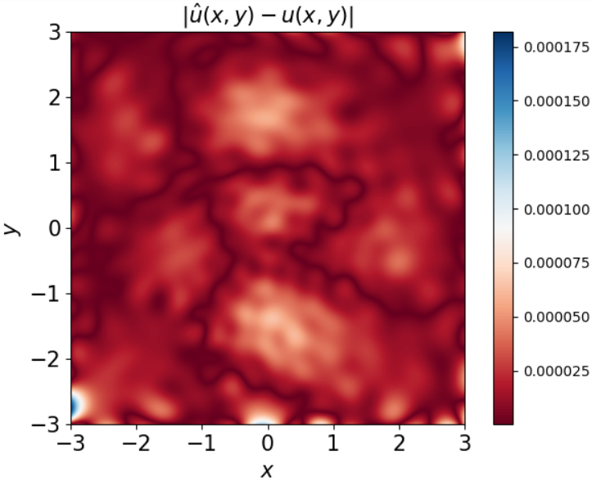
PINN example: 2d elliptic problem (Poisson’s, Laplace’s eq.)
True solution
Predicted solution (PINN)
Absolute error
I. Chaerony Siffa, Kiel Seminar, 23 Jan. 2024

Slide 9
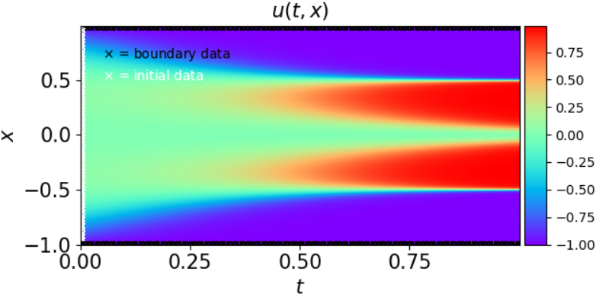
PINN example: time-dependent 1d problem (Allen-Cahn’s eq.)
Automatic
differentiation
Artificial Neural Network (ANN), $\hat{u}=NN(t,x;θ)$
Governing differential equation (DE)
$$σ$$
…
$$σ$$
$$\frac{∂^{2}\hat{u}}{∂x^{2}},\frac{∂\hat{u}}{∂t}$$
$$x$$
$$σ$$
$$σ$$
$$\hat{u}$$
Compare with boundary and initial data
$$t$$
…
…
physical
quantities
input
coordinates
$$σ$$
$$σ$$
Loss formulation
(Total loss = physics loss + boundary loss + initial cond. loss )
True solution
Raissi et al. 2018 J. Comput. Phys. 378 (2019) 686–707
I. Chaerony Siffa, Kiel Seminar, 23 Jan. 2024

Slide 10
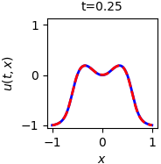
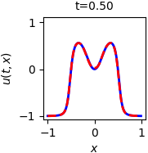
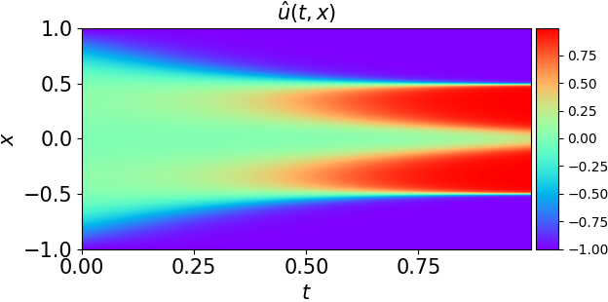
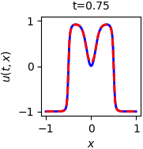
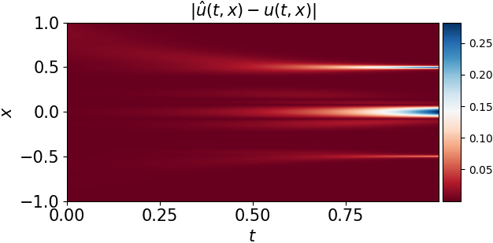
PINN example: time-dependent 1d problem (Allen-Cahn’s eq.)
True solution
Predicted solution (PINN)
Absolute error
Raissi et al. 2018 J. Comput. Phys. 378 (2019) 686–707
I. Chaerony Siffa, Kiel Seminar, 23 Jan. 2024

Slide 11
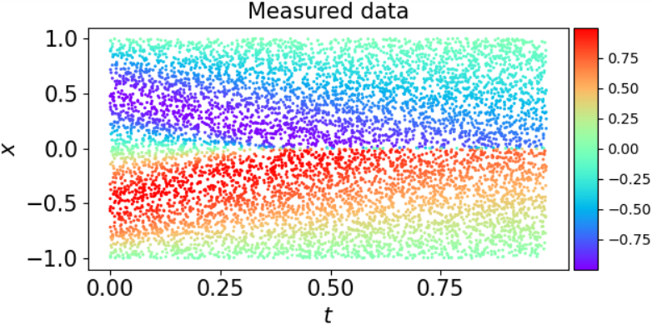
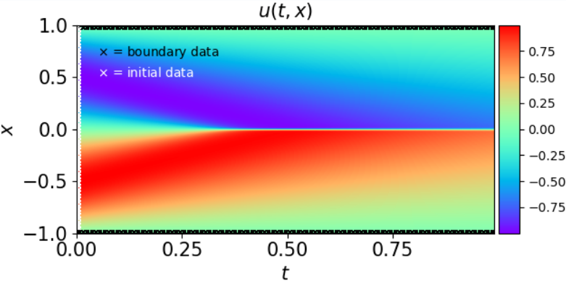
PINN example: time-dependent 1d problem (inverse Burger’s eq.)
Automatic
differentiation
Artificial Neural Network (ANN), $\hat{u}=NN(t,x;θ)$
Governing differential equation (DE)
$$σ$$
…
$$σ$$
$$\frac{∂\hat{u}}{∂x},\frac{∂^{2}\hat{u}}{∂x^{2}},\frac{∂\hat{u}}{∂t}$$
$$x$$
$$σ$$
$$σ$$
$$\hat{u}$$
Compare with boundary, initial, and measured data
The goal is to recover the coefficient values, $λ_{1}$ and $λ_{2}$
$$t$$
…
…
physical
quantities
input
coordinates
$$σ$$
$$σ$$
Loss formulation
(Total loss = physics loss + boundary loss + initial cond. loss + data loss)
Use gradient descent (also) to optimize $\{λ_{1}, λ_{2}\}$
True solution
Raissi et al. 2018 J. Comput. Phys. 378 (2019) 686–707
I. Chaerony Siffa, Kiel Seminar, 23 Jan. 2024

Slide 12
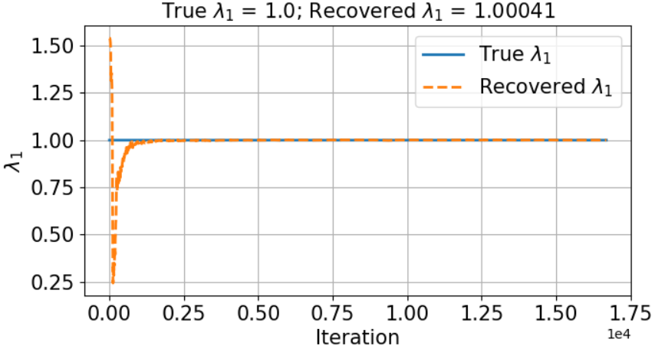
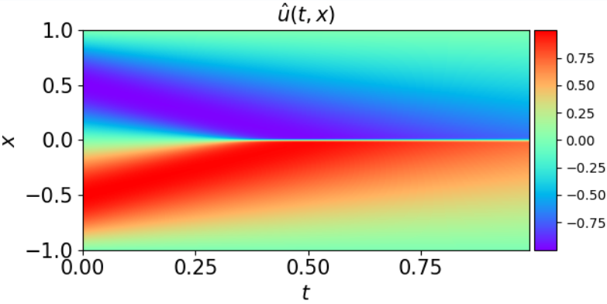
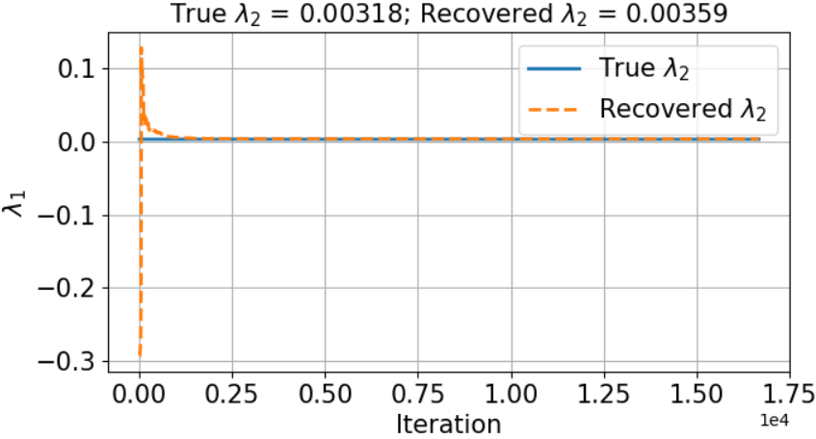
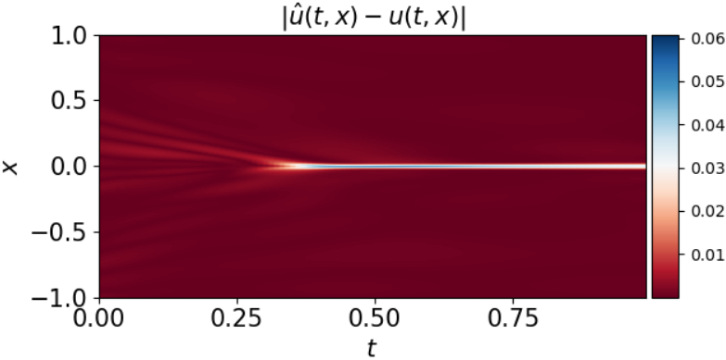
PINN example: time-dependent 1d problem (inverse Burger’s eq.)
True solution
Recovered $λ_{1}$
Predicted solution (PINN)
Recovered $λ_{2}$
Absolute error
Raissi et al. 2018 J. Comput. Phys. 378 (2019) 686–707
I. Chaerony Siffa, Kiel Seminar, 23 Jan. 2024

Slide 13
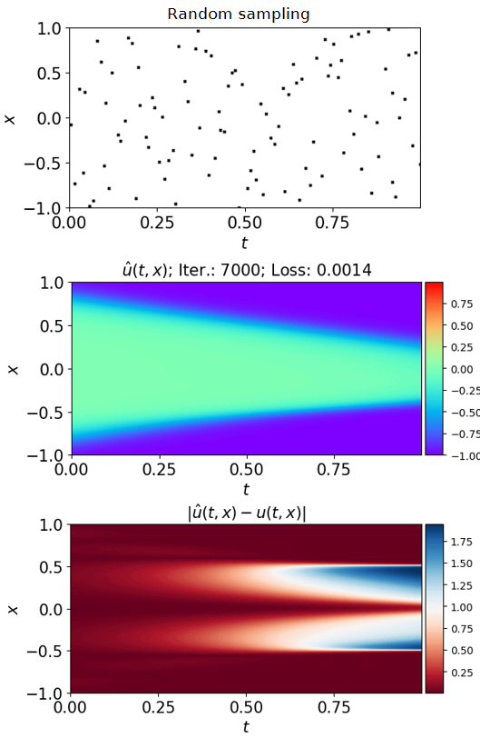
How the training points are sampled?
Randomly sampled training points (t,x)
In the examples, training points are sampled randomly
The ANNs are optimized in a continuous space(-time)
Which means, the PDEs can be “solved implicitly”
No need to specify $Δx$ and $Δt$ (only specify min. and max values)
But it (the ANNs) can also be optimized sequentially^{1,2}
Predicted solution (PINN)
Absolute error
¹Moseley et al. 2023 Adv. Comput. Math. 49 62
²Krishnapriyan et al. in NeurIPS conference 2021. Preprint: arXiv:2009.03730v1
I. Chaerony Siffa, Kiel Seminar, 23 Jan. 2024

Slide 14
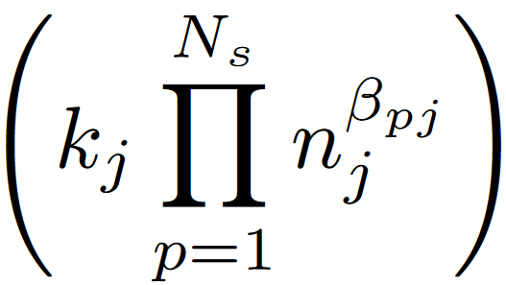
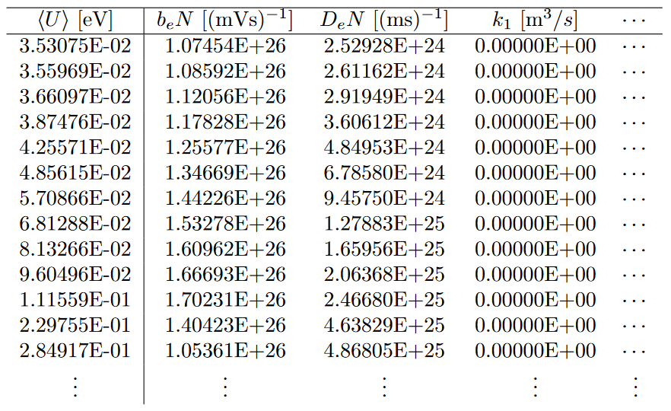
Improving the fluid-Poisson model with PINN
Solve
Boltzmann equation (BE) for electrons²
Obtain the EEDFs (f₀ ,f₁…)
Fluid-Poisson model¹
Rate and transport coefficients
(b_{e}, D_{e}, k_{j},…)
Integrate over the EEDFs
(Balance eq.)
(Source term)
Construct a lookup table (following the LFA or LMEA approaches)
LFA: Local Field Approximation
LMEA: Local Mean Energy Approximation
(Poisson’s eq.)
Inefficient*
Apply machine learning (PINN) to improve the efficiency of rate and transport coefficient determination
(Electron flux eq.)
(Particle flux eq.)
*for large simulations and multidimensional lookup tables
¹Jovanović et al. 2023 Plasma Sources Sci. Technol. 32 044003
²Leyh H, Loffhagen D and Winkler R 1998 Comput. Phys. Commun. 113 33
I. Chaerony Siffa, Kiel Seminar, 23 Jan. 2024

Slide 15
Governing equation – 1/2
Start with the two-term BE under hydrodynamic conditions. Equation for isotropic distribution $f_{0}$:
(1)
with
Equation for the first anisotropic component $f_{1}$: With the mean free path $λ(U)$:
(2)
Leyh H, Loffhagen D and Winkler R 1998 Comput. Phys. Commun. 113 33
I. Chaerony Siffa, Kiel Seminar, 23 Jan. 2024

Slide 16
Governing equation – 2/2
Plug equation (2) into equation (1):
Not PINN friendly
Expand the equation above using the product rule to get rid of the nested derivatives:
(DE residual)
PINN friendly
Leyh H, Loffhagen D and Winkler R 1998 Comput. Phys. Commun. 113 33
I. Chaerony Siffa, Kiel Seminar, 23 Jan. 2024

Slide 17
Governing equation – 2/2
Plug equation (2) into equation (1):
Not PINN friendly
Expand the equation above using the product rule to get rid of the nested derivatives:
(DE residual)
PINN friendly
Calculated using automatic-differentiation at every iteration during training
Calculated using conventional method only once at the beginning of training
Leyh H, Loffhagen D and Winkler R 1998 Comput. Phys. Commun. 113 33
I. Chaerony Siffa, Kiel Seminar, 23 Jan. 2024

Slide 18
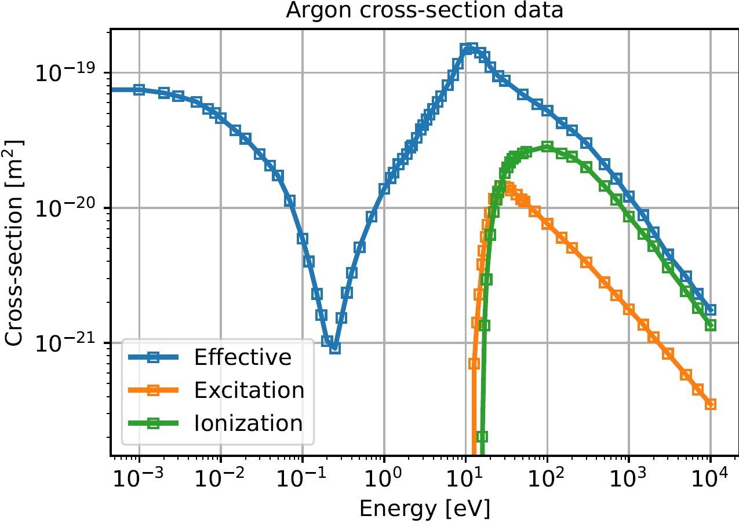
Reaction scheme and cross-section data for electrons in Argon gas
Reactions:
Conditions:
Gas temperature ($T_{gas}$) = 273.14 K
Pressure ($P$) = 133.322 Pa
Varying reduced electric fields or mean electron energy
Cross-sections:
Yamabe, Buckman, and Phelps 1983 Phys. Rev. 27 1345
PHELPS database, http://www.lxcat.laplace.univ-tlse.fr, retrieved June 4, 2013.
I. Chaerony Siffa, Kiel Seminar, 23 Jan. 2024

Slide 19
PINN example: parametrically solve the electron Boltzmann equation
$$E/N$$
Automatic
differentiation
Artificial neural network (ANN)
$$σ$$
…
$$σ$$
Solve for any E/N value within the same optimization process
$$E/N$$
$$σ$$
$$σ$$
$$\frac{d{\hat{f}}_{0}}{dU},\frac{d^{2}{\hat{f}}_{0}}{dU^{2}}$$
$${\hat{f}}_{0}$$
Compute residuals
…
…
$$U$$
$$σ$$
$$σ$$
Converged?
Loss function
End
Related work:
Kawaguchi et al. 2020 Plasma Sources Sci. Technol. 29 025021
Kim et al. 2023 J. Phys. D: Appl. Phys. 56 344002
I. Chaerony Siffa, Kiel Seminar, 23 Jan. 2024

Slide 20
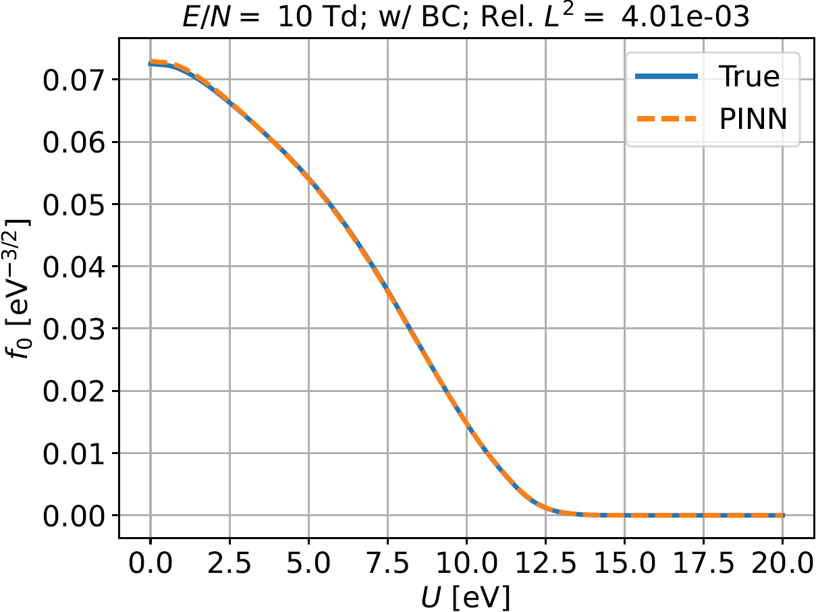
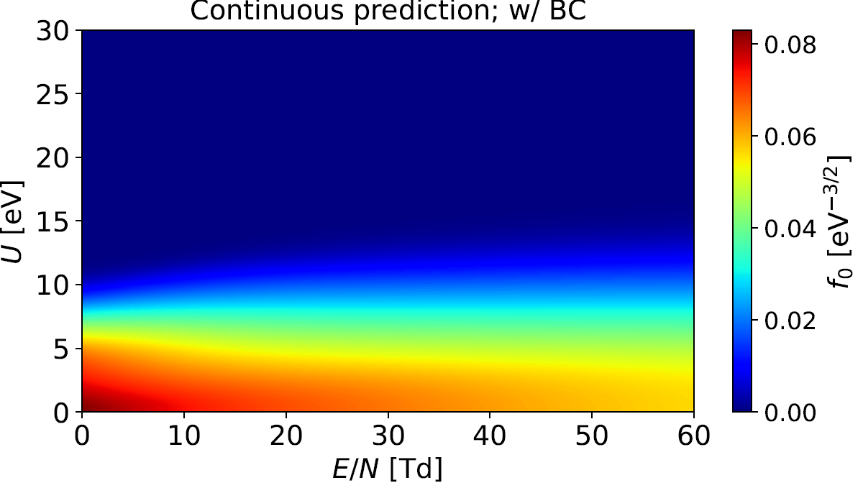
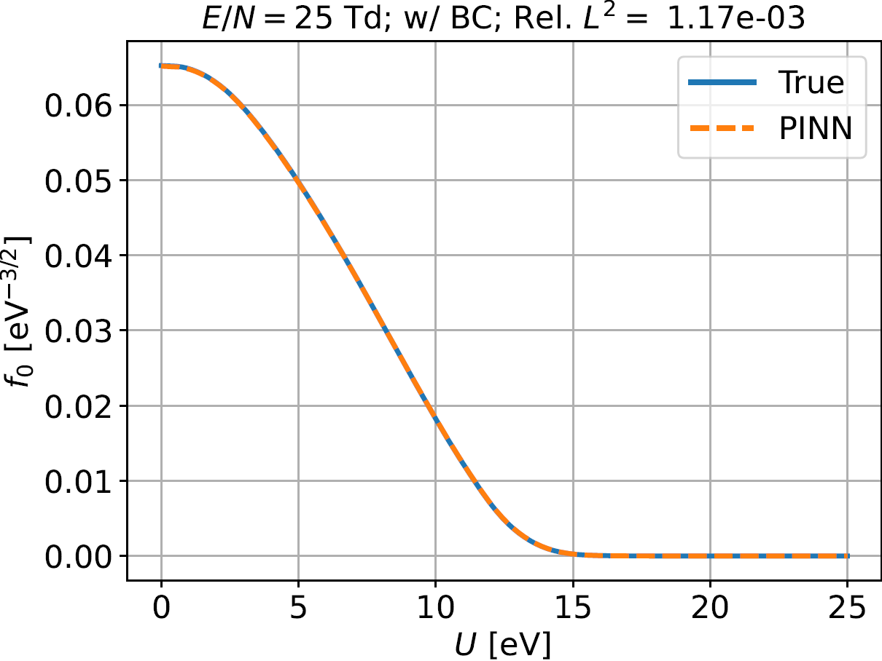
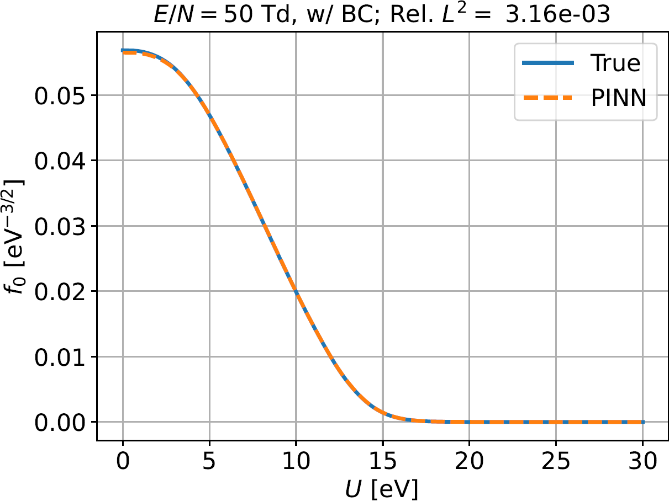
PINN example: parametrically solve the electron Boltzmann equation
Results on E/N = [10, 50] Td
E/N = 10 Td
Continuous prediction of the EEDF (f₀)
E/N = 25 Td
Training points E/N = [10, 50] Td
The ANN is not explicitly trained on this point E/N = 25 Td
Training took around 3 hours. But evaluation of the trained model takes $\sim$19.6 ms for one million points (on a GPU)
E/N = 50 Td
I. Chaerony Siffa, Kiel Seminar, 23 Jan. 2024

Slide 21
(In the near) future work and the goal
Artificial neural network (ANN)
Automatic
differentiation
(In the near) future work:
High-dimensional problem
Need to use a different formulation of the equation
Need better architecture
Need better optimization scheme
$$E/N$$
$$σ$$
$$σ$$
…
Solve spatially-inhomogeneous BE for any E/N and n_{h} values within the same optimization process
$$z$$
$$\frac{∂{\hat{f}}_{0}}{∂U},\frac{∂^{2}{\hat{f}}_{0}}{∂U^{2}}$$
$$U$$
$$σ$$
$$σ$$
$${\hat{f}}_{0}$$
$$\frac{∂{\hat{f}}_{0}}{∂x},\frac{∂^{2}{\hat{f}}_{0}}{∂x^{2}}$$
$$n_{1}$$
…
…
…
$$σ$$
$$σ$$
$$n_{h}$$
accuracy
The goal:
Particle-in-Cell /
Monte Carlo collision
fluid-Poisson
model + ML
Fluid-Poisson model + ML approach = better accuracy with a slight addition in computational cost
fluid-Poisson
model
computational cost
I. Chaerony Siffa, Kiel Seminar, 23 Jan. 2024

Slide 22
Challenges (that I have encountered so far…)
Vanishing gradient
PINNs ‘stop’ learning at some point which results in suboptimal accuracy
No one model to rule them all
Different PDEs may need a different set of hyperparameters, ANN architecture, and optimization strategy
Spectral bias of ANN
Hard to train / it takes forever to train ANNs to approximate functions with a lot of high-frequency components
Accuracy of PINNs is not as good as traditional solvers, but maybe just good enough for your use cases(?!)
Moseley et al. 2023 Adv. Comput. Math. 49 62
Wang et al. 2021 SIAM J. Sci. Comput. 43 A3055-A3081
Wang et al. 2021 Comput. Methods Appl. Mech. Engrg. 384 113938
I. Chaerony Siffa, Kiel Seminar, 23 Jan. 2024

Slide 23
Concluding remarks
Mesh free: no need for discretization
Direct integration of measurement data into the physical model (equations)
Require little to no solution data to train (important data: boundary and initial conditions)
Allow for recovering PDE coefficients from measurement data (inverse problems)
Allow for parametrically solving the equations within the same optimization process
Slow to train, very fast to evaluate
Depends on the use case, PINNs can be faster than traditional solvers
Thank you!
I. Chaerony Siffa, Kiel Seminar, 23 Jan. 2024

Slide 24
Acknowledgement
Many thanks to PD Dr. Detlef Loffhagen for many fruitful discussions on solving the multi-term Boltzmann equation for electrons and for generating the reference solutions.
Thank you!
I. Chaerony Siffa, Kiel Seminar, 23 Jan. 2024

Slide 25
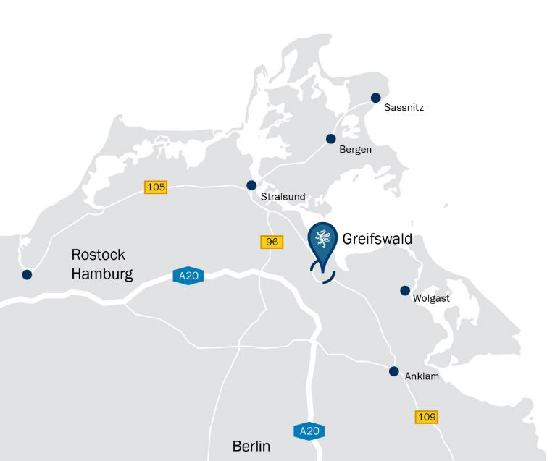
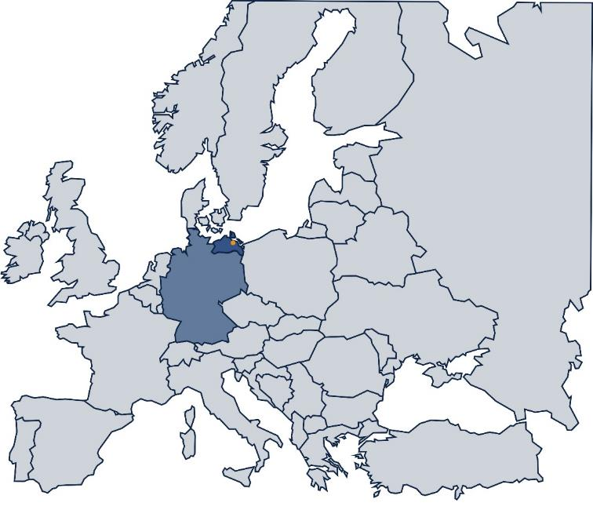
Contact
Leibniz Institute for Plasma Science and Technology (INP)
Address: Felix-Hausdorff-Str. 2, 17489 Greifswald
Phone: +49 - 3834 - 554 300, Fax: +49 - 3834 - 554 301
E-Mail: welcome@inp-greifswald.de, Web: www.leibniz-inp.de

